Slide 1
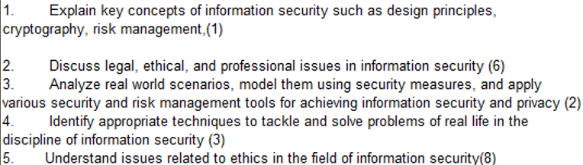
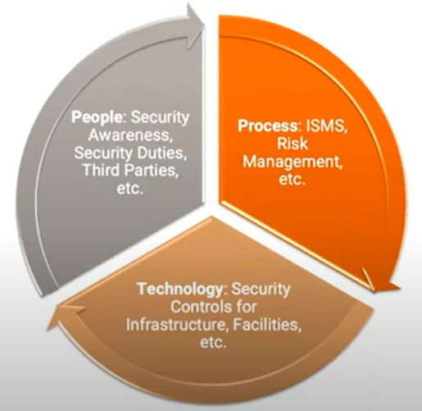
CS 3002 Information Security
Fall 2024
Week # 3 – Lecture # 7, 8, 9
3rd – 5th September 2024
Dr. Aqsa Aslam

Slide 2

Comments DES
Security of DES
Knowing the DES algorithm alone does not allow an attacker to decrypt data without the secret key.
Due to the small key size (56 bits), DES is no longer considered secure against determined attackers with access to modern computing resources.
DES is seen as very secure (except for the key length)
No attacks with lower costs than a Brute Force attack are known as far
There are some so-called weak keys and semi-weak keys
These keys should not be used!
Modern Alternatives: Due to its weaknesses, DES has been replaced by stronger algorithms like AES (Advanced Encryption Standard) or Triple DES (3DES), which use larger key sizes and more complex encryption processes to provide better security.

Slide 3
Choosing the S-boxes and P-box
Choosing the S-boxes and P-box at random would result in an insecure block cipher (key recovery after ≈2²⁴ outputs) [BS’89]
Several rules used in choice of S and P boxes:
No output bit should be close to a linear function of the input bits
Ensure that bits of the output of an S-Box on one round affects the input of multiple S-Boxes in the next round
Two of the output bits of one S-Box should influence the middle of the result, the other two bits should influence the edges
The 4 output bits should form the input of 6 S-Boxes in the next round

Slide 4
DES → To Summarize
S-Boxes
The design provides confusion (non-linearity) of bits from each round to the next.
P-Boxes
They provide diffusion of bits.
Number of Rounds
DES uses sixteen rounds of Feistel ciphers. the ciphertext is thoroughly a random function of plaintext and ciphertext.

Slide 5
DES Properties
Two desired properties of a block cipher are the completeness and the avalanche effect.
Completeness effect means that each bit of the ciphertext needs to depend on many bits on the plaintext
Avalanche effect means a small change in either the plaintext or the key should produce a significant change in the ciphertext.
The avalanche effect is in fact a measure of diffusion.
Remark: Linear functions are usually for diffusion.

Slide 6
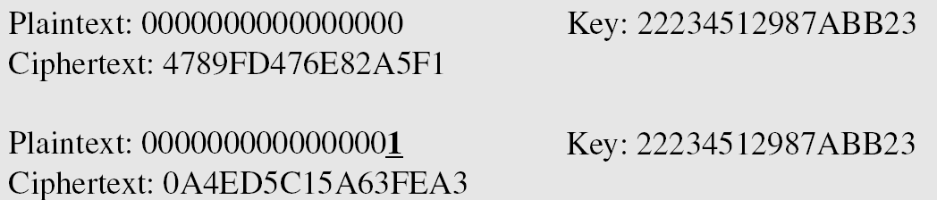
Example of Avalanche Effect
To check the avalanche effect in DES, let us encrypt two plaintext blocks (with the same key) that differ only in one bit and observe the differences in the number of bits in each round.

Slide 7
Example of Avalanche Effect
Although the two plaintext blocks differ only in the rightmost bit, the ciphertext blocks differ in 29 bits. This means that changing approximately 1.5 percent of the plaintext creates a
change of approximately 45 percent in the ciphertext.
Number of bit differences for Example

Slide 8
Security of DES
DES, as the first important block cipher, has gone through much scrutiny. Among the attempted attacks, three are of interest:
Brute-force
Due to the weakness of short cipher key DES can be broken using 2⁵⁵ encryptions.
Differential Cryptanalysis
Analyzes how differences in input can affect the resultant differences at the output.
It has been revealed that the designers of DES already knew about this type of attack and designed S-boxes and chose 16 as the number of rounds to make DES specifically resistant to this type of attack.
Linear Cryptanalysis
Analyzes the relationship between plaintext, ciphertext, and key using linear
Linear cryptanalysis is newer than differential cryptanalysis. DES is more vulnerable to linear cryptanalysis than to differential cryptanalysis. S-boxes are not very resistant to linear cryptanalysis. It has been shown that DES can be broken using 2⁴³ pairs of known plaintexts. However, from the practical point of view, finding so many pairs is very unlikely.
Notes:
Differential CryptAnalysis: how differences in information input can affect the resultant difference at the output.
Linear CryptAnalysis:

Slide 9
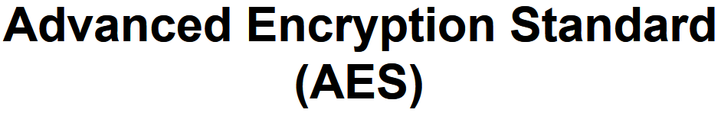

Slide 10
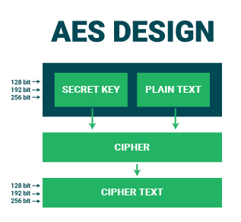
AES (Advanced Encryption Standard)
AES (Advanced Encryption Standard) is a non-Feistel cipher.
Encrypts and decrypts data blocks of 128 bits.
Operates with three versions, using 10, 12, or 14 rounds.
Key sizes available:
128, 192, or 256 bits, which correspond to the number of rounds.
Regardless of the key size, the round keys are always 128 bits.

Slide 11
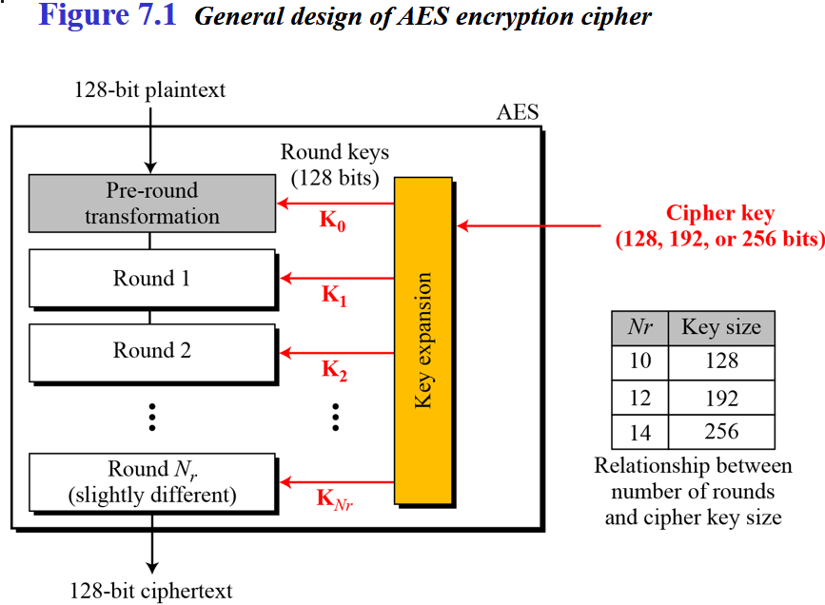
Fixed size=128 bit i-e., 16bytes
→ No: of key generated =no: of round+1(extra for pre-round transformation)

Slide 12
AES - steps
KeyExpansion — round keys are derived from the cipher key using Rijndael's key schedule.
Initial Round
AddRoundKey—each byte of the state is combined with the round key using bitwise xor.
Round
Four different stages are used, one of permutation and three of substitution:
Substitute Bytes: Uses a table, referred to as an S-box,3 to perform a byte-by-byte substitution of the block
Shift Rows: A simple permutation that is performed row by row
Mix Columns: A substitution that alters each byte in a column as a function of all of the bytes in the column
Add Round key: A simple bitwise XOR of the current block with a portion of the expanded key
Final Round (no Mix-Columns)
SubBytes
ShiftRows
AddRoundKey
TRANSFORMATIONS
Four different stages are used, one of permutation and three of substitution:
Substitute Bytes: Uses a table, referred to as an S-box,3 to perform a byteby-byte substitution of the block
Shift Rows: A simple permutation that is performed row by row
Mix Columns: A substitution that alters each byte in a column as a function of all of the bytes in the column
Add Round key: A simple bitwise XOR of the current block with a portion of the expanded key

Slide 13
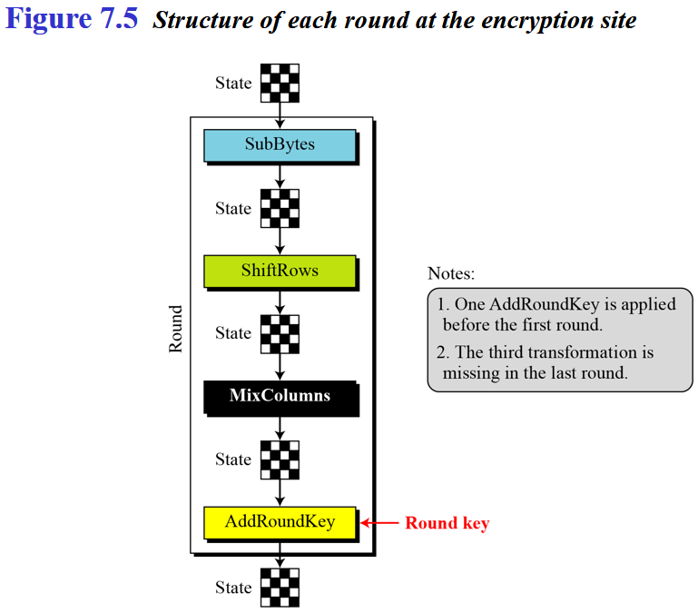
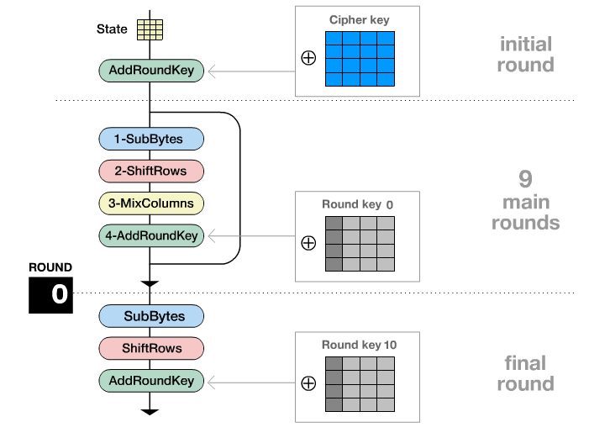
AES → Encryption Process

Slide 14
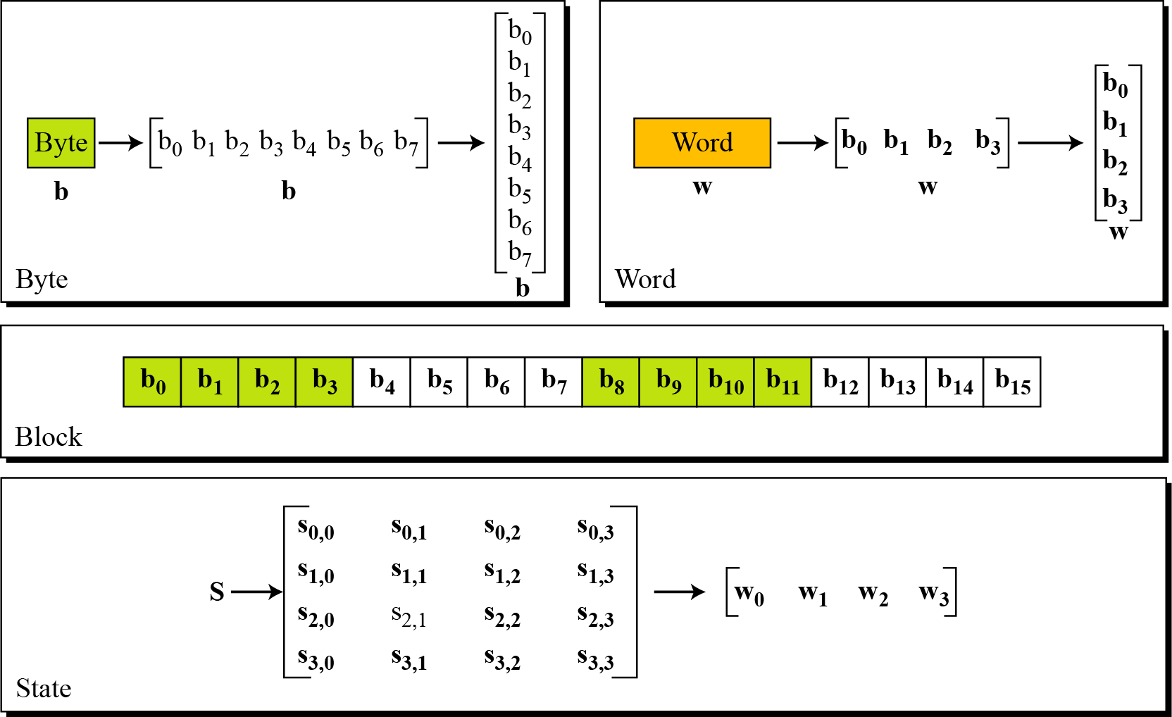
Data Units.
1 byte= group of 8 bit
1 word=4 bytes=32 bit
Block size=128 bit data
Figure 7.2 Data units used in AES
4 word
4×4=16 bytes i-e
128 bits or 4 words
1 byte
S_{0,0 =}1st byte of 0th word
1 word
State: it told intermediate result

Slide 15
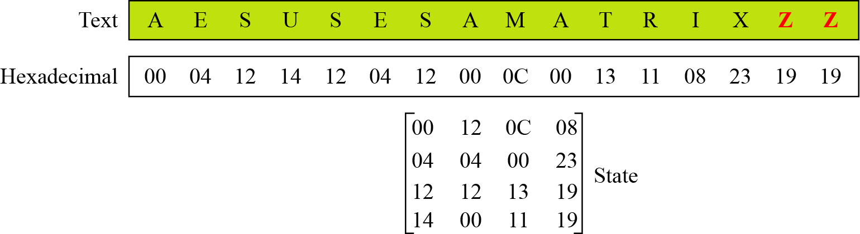
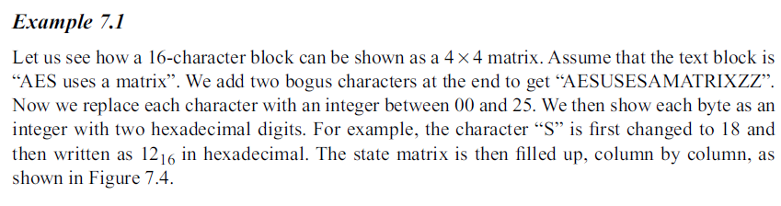
7.1.4 Continue
Example 7.1
Continue
Figure 7.4 Changing plaintext to state

Slide 16
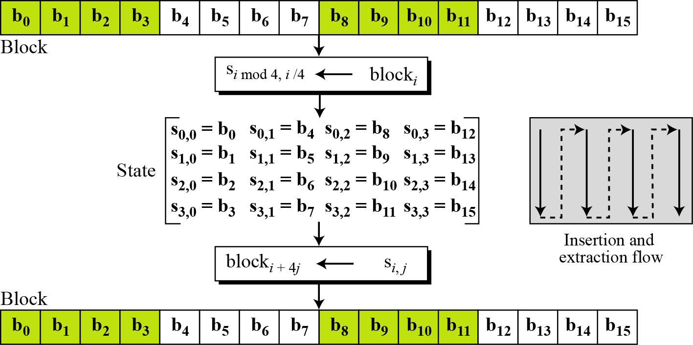
7.1.4 Data Units.
Figure 7.3 Block-to-state and state-to-block transformation

Slide 17

7.2.1 Substitution
SubBytes
AES, like DES, uses substitution. AES uses two invertible transformations.
SubBytes
The first transformation, SubBytes, is used at the encryption site. To substitute a byte, we interpret the byte as two hexadecimal digits.
Note
The SubBytes operation involves 16 independent byte-to-byte transformations.

Slide 18
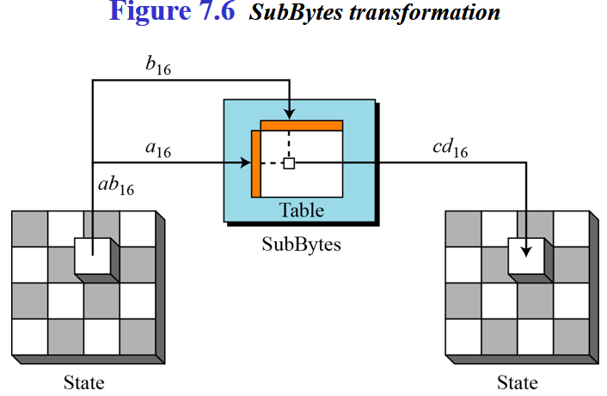
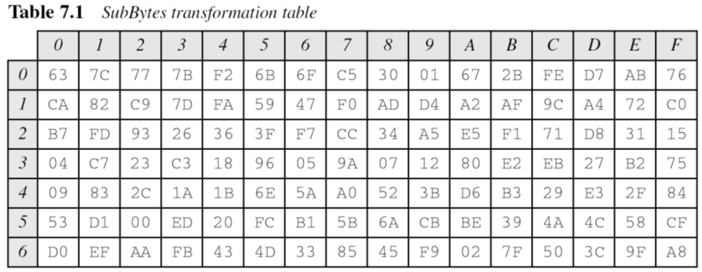
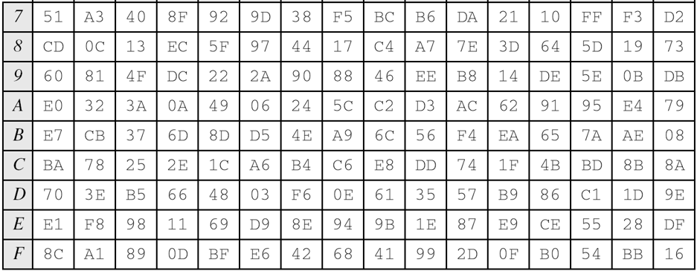
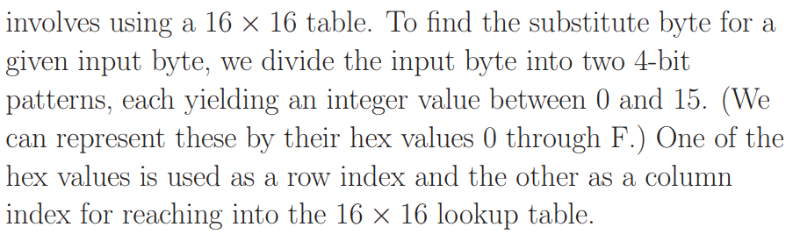





16×16= S-box
SubBytes is simply a table lookup using a 16×16 matrix of byte values called an s-box.
This matrix consists of all the possible combinations of an 8 bit sequence (28= 16×16 = 256).

Slide 19
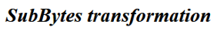
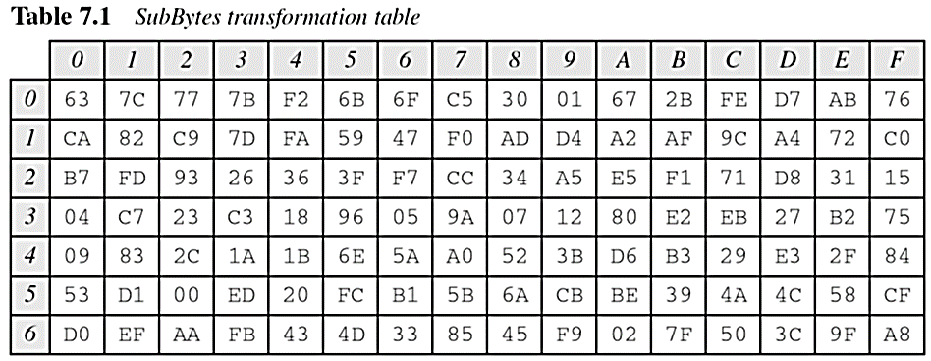
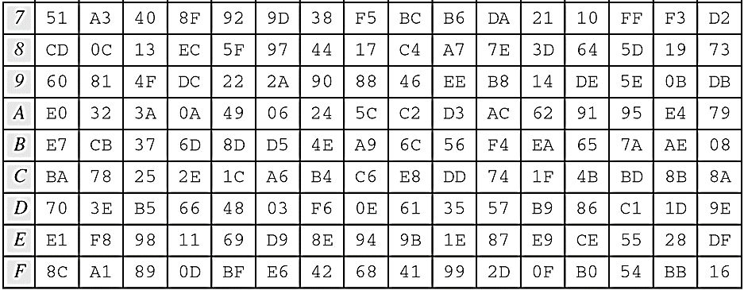
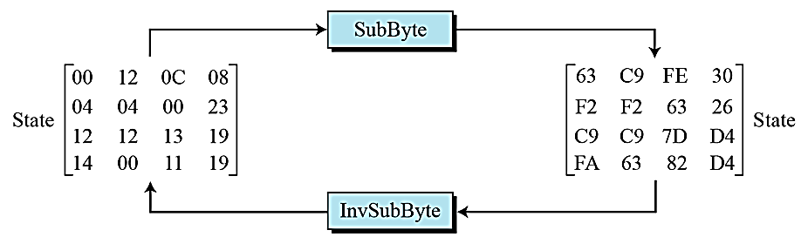
16×16= S-box

Slide 20
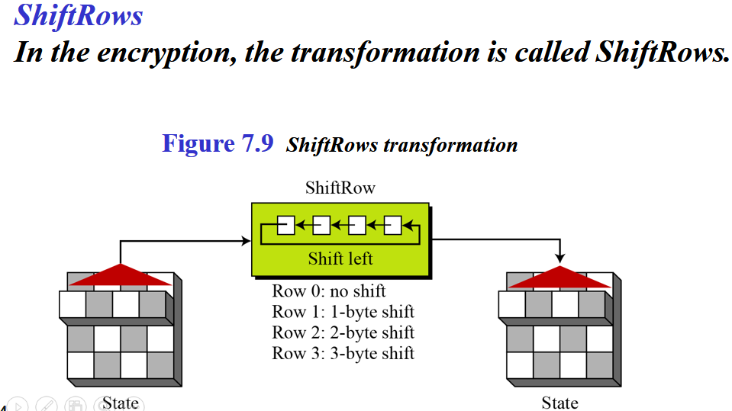
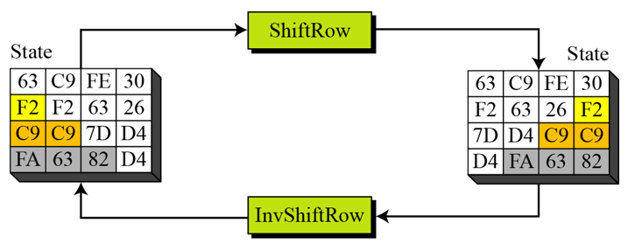
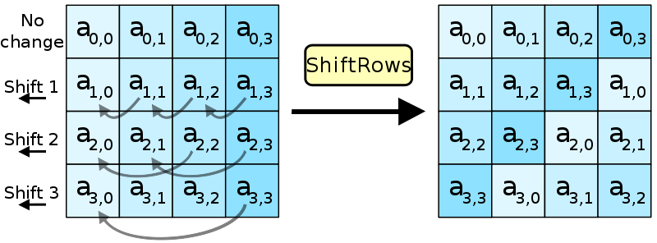
Permutation perform on a byte level
Shift is done to the left
Shift depends on the nrow of the matrix

Slide 21
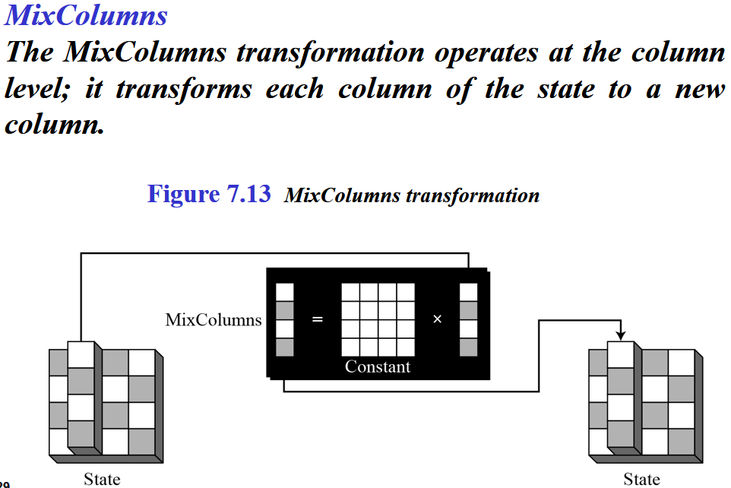
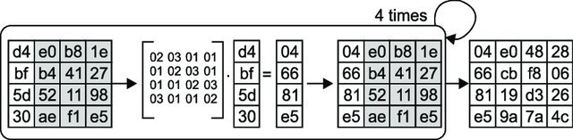
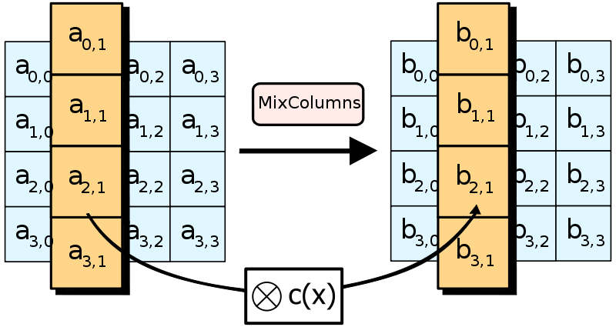
In the MixColumns step, each column of the state is multiplied with a fixed polynomial c(x).

Slide 22
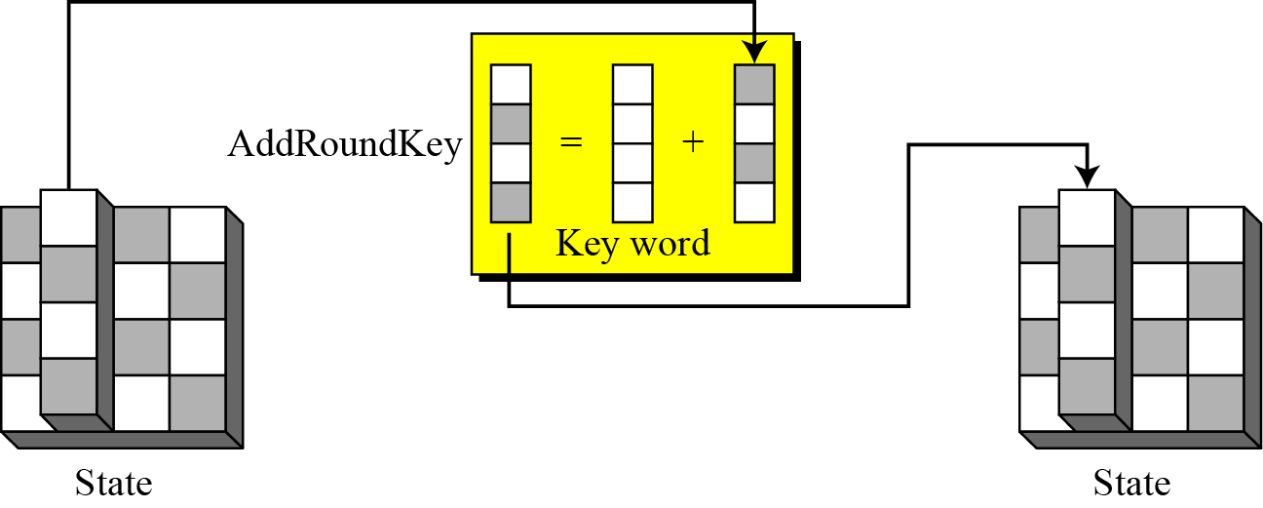
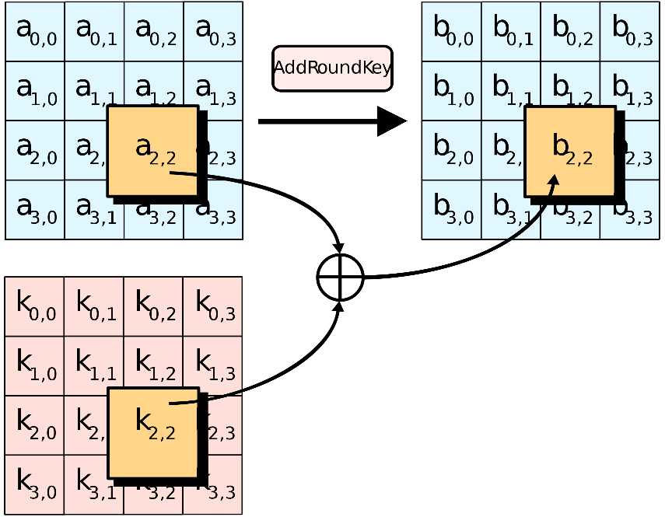
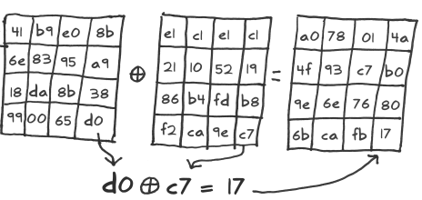
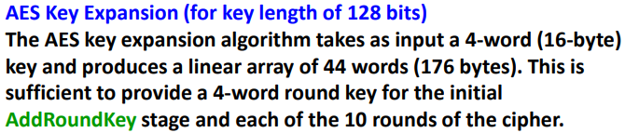
AddRoundKey
In the forward add round key transformation, called AddRoundKey, the 128 bits of State are bitwise XORed with the 128 bits of the round key.
Figure 7.15 AddRoundKey transformation

Slide 23
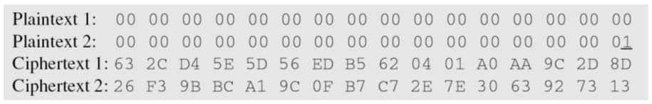
Claude Shannon (1949) gave two properties that a good cryptosystem should have to hinder statistical analysis: diffusion and confusion.
Diffusion means that if we change a character of the plaintext, then several characters of the ciphertext should change, and similarly, if we change a character of the ciphertext, then several characters of the plaintext should change.
Confusion means that the key does not relate in a simple way to the ciphertext. In particular, each character of the ciphertext should depend on several parts of the key.
Confusion = Substitution a --> b, Diffusion = Transposition or Permutation abcd --> dacb

Slide 24
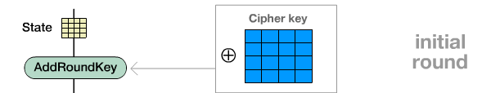
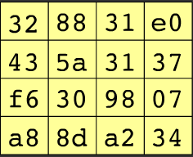
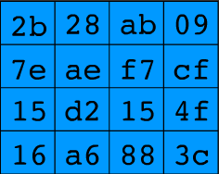
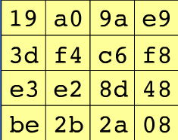


Example (Initial round)

Slide 25
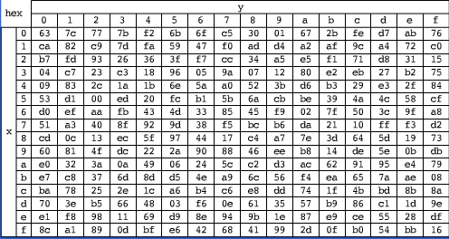
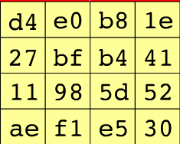
Example (R1-SubBytes)
SubBytes

Slide 26
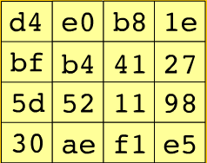
Example (R1-ShiftRows)
ShiftRows

Slide 27
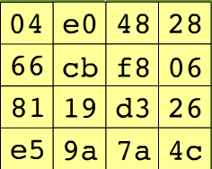
Example (R1-MixColumns)
MixColumns

Slide 28
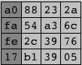
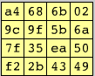
Example (R1-AddRoundKey)
AddRoundKey

Slide 29
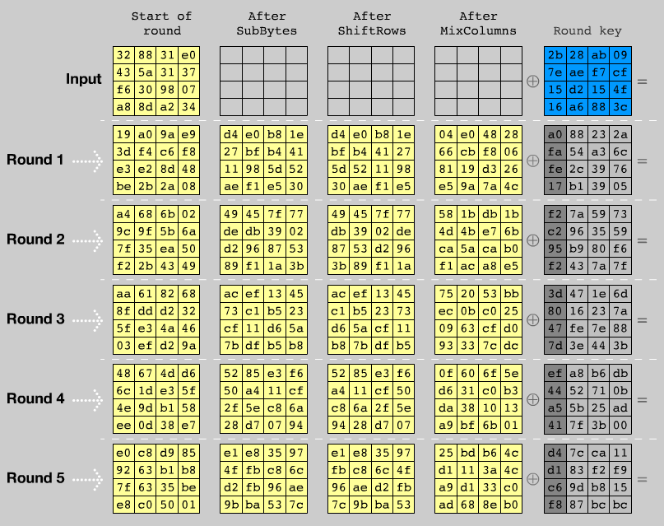

Slide 30
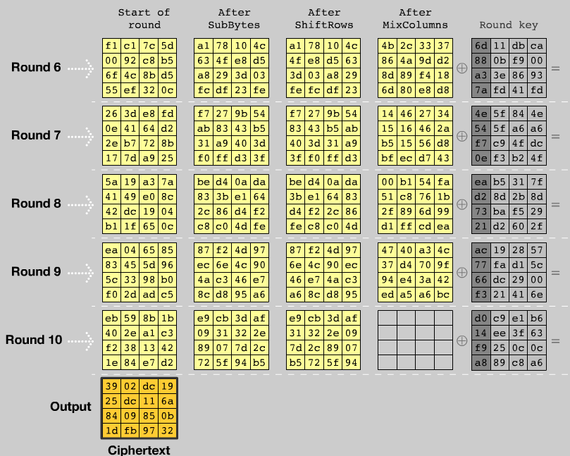

Slide 31


Example: Javascript AES
AES in the browser:
AES library (6.4KB)
no pre-computed tables
Prior to encryption: pre-compute tables
Then encrypt using tables
http://crypto.stanford.edu/sjcl/
Notes:
http://crypto.stanford.edu/sjcl/
The browser inflates the implementation and
Shrink the code so there is small traffic in the network
As the code lands on the browser the browser does all the precomputation and code inflates itself.

Slide 32
AES in hardware
AES instructions in Intel Westmere:
aesenc, aesenclast: do one round of AES
128-bit registers: xmm1=state, xmm2=round key
aesenc xmm1, xmm2 ; puts result in xmm1
aeskeygenassist: performs AES key expansion
Claim 14 x speed-up over OpenSSL on same hardware
Similar instructions on AMD Bulldozer
Notes:
To implement AES called aesenc 9 times and then call aesenclast.
AES is such a popular block cipher, Intel has added support AES in the processor. There are specific commands
Aesenc essentially implement one round of AES (3 functions)
Aesenclast implement the last round (remember there is no mix column)

Slide 33
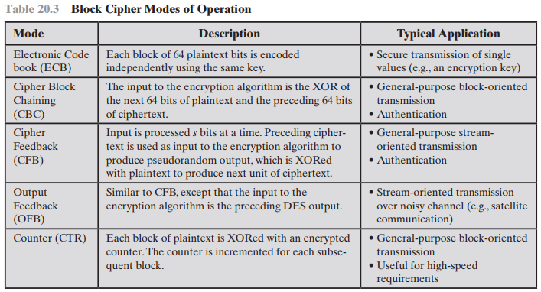

Slide 34
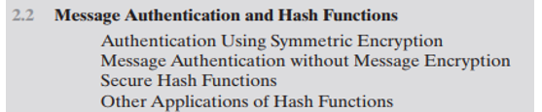

Slide 35
Message Authentication
Encryption: Protects against passive attacks (e.g., eavesdropping).
Message/Data Authentication: Protects against active attacks (e.g., data falsification, transaction tampering) by ensuring message integrity and authenticity.
Verifies the authenticity and integrity of messages,
ensuring they are genuine, unaltered, and from the claimed source.
Concerns:
Integrity: Content remains unchanged.
Source Authenticity: Confirms the sender's identity.
Timeliness: Prevents delayed or replayed messages.
Sequencing: Ensures correct order of data.
Protects against active attacks
Verifies received message is authentic
Contents have not been altered
From authentic source
Timely and in correct sequence
Can use conventional encryption
Only sender and receiver share a key

Slide 36
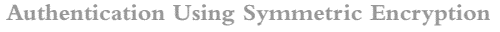
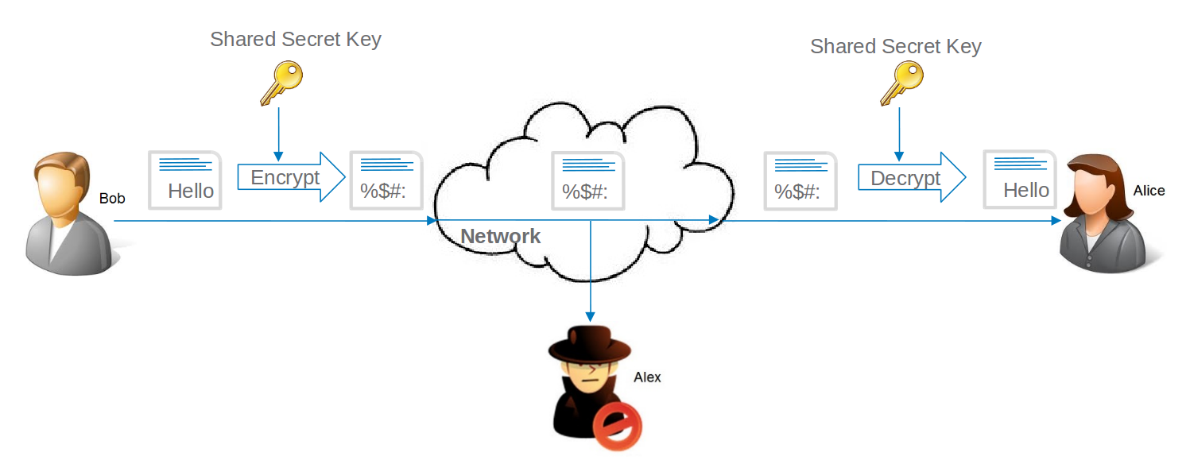
Concept: Shared key allows the genuine sender to encrypt a message for the receiver.
Additional Elements:
Error-Detection Code: Ensures message integrity.
Sequence Number: Maintains correct order of messages.
Timestamp: Verifies timely delivery.
Limitations:
ECB Mode Vulnerability: Block reordering can change the meaning of the data sequence, even though decryption is successful.
Sequence Number Limitations: Typically, no unique sequence number for each block of plaintext, making block reordering a potential threat.
Not Fully Adequate: Symmetric encryption alone does not provide complete data authentication.

Slide 37
Approach: Authentication tags are appended to messages, which are sent in plaintext.
No Confidentiality: Message content is not encrypted, so confidentiality is not provided.
Authentication and confidentiality can be combined by encrypting the message along with its authentication tag, though they are typically handled separately.
Three situations in which message authentication without confidentiality is preferable:
Broadcast Messages:
Used in systems that send the same message to multiple recipients (e.g., network notifications, alarm signals).
Ensures that only one designated destination verifies authenticity, reducing overhead and complexity.
Allows plaintext broadcasting with an authentication tag, and alerts are sent if authenticity is violated
Selective Authentication:
In scenarios where one party has a high processing load, decrypting all incoming messages may be impractical.
Authentication is performed selectively, checking the integrity of randomly chosen messages to save resources.
Program Integrity
Useful for verifying the integrity of executable programs without decrypting them each time they are run.
Ensures that the program is authentic and unaltered while conserving processor resources by avoiding repeated decryption.
Both authentication and encryption are essential for comprehensive security, each serving specific needs.

Slide 38
A MAC is used to verify both the integrity and authenticity of a message using a shared secret key between the sender and receiver.
Uses a secret key to generate a small block of data (MAC) appended to the message.
Two communicating parties, say A and B, share a common secret key K_{AB}.
When A has a message to send to B, it calculates the message authentication code as a complex function of the message and the key:
MAC_{M} = F(K_{AB}, M).
The message plus code are transmitted to the intended recipient.
The recipient performs the same calculation on the received message, using the same secret key, to generate a new message authentication code.
The received code is compared to the calculated code and if the received code matches the calculated code, then:
The receiver is assured that the message has not been altered The receiver is assured that the message is from the alleged sender.
MACs are good at detecting changes and confirming the message's authenticity, making them strong against forgery.
Encryption focuses on keeping messages secret, so it’s mainly about preventing unauthorized access.

Slide 39
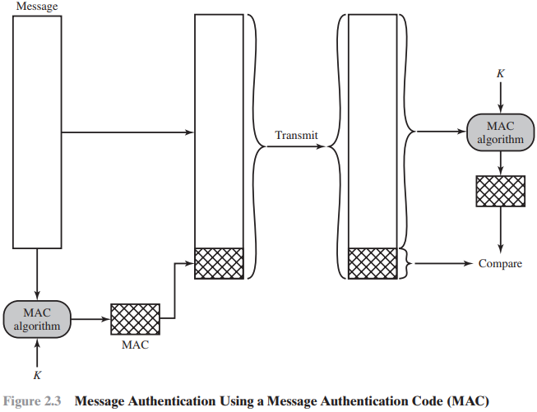
Key Differences from Encryption:
MAC algorithms do not require reversibility, unlike encryption algorithms used for confidentiality.
The non-reversible nature of MAC functions adds an extra layer of security, making them more resistant to certain types of cryptographic attacks compared to encryption.
DES or AES is used to generate an encrypted version of the message, and some of the bits of ciphertext are used as the code. Longer codes are used to provide sufficient collision resistance.

Slide 40
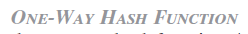
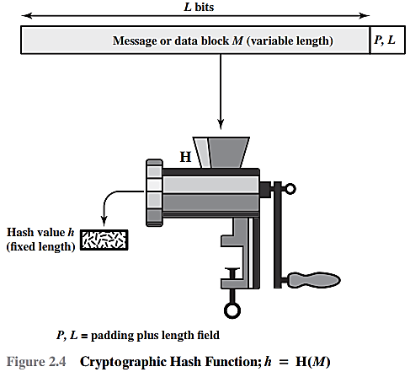

Purpose: Used as an alternative to the Message Authentication Code (MAC) for ensuring data integrity and authenticity.
Functionality:
Input: Takes a variable-size message M.
Output: Produces a fixed-size message digest H(M).
Padding:
The message is padded to an integer multiple of a fixed length (e.g., 1024 bits).
Padding includes the length of the original message in bits as a security measure to prevent attacks that could generate the same hash value for different messages.
To accommodate variable size messages or data blocks
Key Differences from MAC:
Unlike MACs, hash functions do not use a secret key.
A hash function purely generates a digest from the message itself.

Slide 41


HMAC Concept

Slide 42


Purpose: Used as an alternative to the Message Authentication Code (MAC) for ensuring data integrity and authenticity.

Slide 43

Purpose: Used as an alternative to the Message Authentication Code (MAC) for ensuring data integrity and authenticity.

Slide 44

Reasons to Avoid Full Encryption:

Slide 45
Three ways in which the message can be authenticated using a hash function
(Figure 2.5 )
Notes:
Unlike the MAC, a hash function does not also take a secret key as input.
To authenticate a message, the message digest is sent with the message in such
a way that the message digest is authentic. Figure 2.5 illustrates three ways in
which the message can be authenticated using a hash code. The message digest
can be encrypted using symmetric encryption (part a); if it is assumed that only
the sender and receiver share the encryption key, then authenticity is assured. The
message digest can also be encrypted using public-key encryption (part b); this is
explained in Section 2.3. The public-key approach has two advantages: It provides
a digital signature as well as message authentication; and it does not require the
distribution of keys to communicating parties.
These two approaches have an advantage over approaches that encrypt the
entire message in that less computation is required. But an even more common approach is
the use of a technique that avoids encryption altogether. Several reasons
for this interest are pointed out in [TSUD92]:
• Encryption software is quite slow. Even though the amount of data to be
encrypted per message is small, there may be a steady stream of messages into
and out of a system.
• Encryption hardware costs are non-negligible. Low-cost chip implementations
of DES are available, but the cost adds up if all nodes in a network must have
this capability.
• Encryption hardware is optimized toward large data sizes. For small blocks of
data, a high proportion of the time is spent in initialization/invocation overhead.
• An encryption algorithm may be protected by a patent.
Figure 2.5c shows a technique that uses a hash function but no encryption
for message authentication. This technique, known as a keyed hash MAC, assumes
that two communicating parties, say A and B, share a common secret key K.
This secret key is incorporated into the process of generating a hash code. In the
approach illustrated in Figure 2.5c, when A has a message to send to B, it calculates
the hash function over the concatenation of the secret key and the message:
MD_{M} = H(K ll M ll K). It then sends [ M ii MD_{M}] to B. Because B possesses K, it can
recompute H(K ll M ll K) and verify MD_{M}. Because the secret key itself is not sent, it
should not be possible for an attacker to modify an intercepted message. As long as
the secret key remains secret, it should not be possible for an attacker to generate a
false message.
Note that the secret key is used as both a prefix and a suffix to the message. If
the secret key is used as either only a prefix or only a suffix, the scheme is less secure.
This topic is discussed in Chapter 21. Chapter 21 also describes a scheme known
as HMAC, which is somewhat more complex than the approach of Figure 2.5c and
which has become the standard approach for a keyed hash MAC.

Slide 46

Symmetric Encryption of the Hash (a)
How it Works: The sender creates a hash (a small, unique representation) of the message and encrypts it using a shared secret key that both the sender and receiver know.
Purpose: Only someone with the same secret key can decrypt the hash, ensuring that the message is authentic and hasn't been altered.
Encryption ensures that only parties with the secret key can authenticate and verify the integrity of the message, preventing forgery and tampering.

Slide 47

Public-Key Encryption of the Hash (b)
Purpose: This method not only verifies that the message is authentic and unchanged but also serves as a digital signature, confirming the sender’s identity.
This approach doesn’t require sharing a secret key in advance.
Will discussed in 2.3 sec Public Key Encryption
The public key approach has two advantages:
It provides a digital signature as well as message authentication,
It does not require the distribution of keys to communicating parties.

Slide 48

Using secret value (c)
How it Works: Both the sender and receiver share a secret key. The sender combines this secret key with the message, generates a hash, and sends both the message and hash. The receiver uses the same key to recreate the hash and verify it matches the one received.
When A has a message to send to B, it calculates the hash function over the concatenation of the secret key and the message:
MD_{M} = H(K ll M ll K)
It then sends [ M ii MD_{M}] to B. Because B possesses K, it can re-compute H(K ll M ll K) and verify MD_{M}.
Purpose: This method ensures that the message is authentic because only those with the shared secret key can create or verify the hash.
Ensures message integrity and authenticity similar to MAC but uses the key in a more secure way.
Widely used and standardized (e.g., HMAC-SHA256).

Slide 49



Slide 50




Prevents attackers from finding the input using the hash value.
Prevents attackers from substituting a different input with the same hash value as the original.
Prevents attackers from finding two distinct inputs that produce the same hash value.

